Slide 1


Government registered Certificate

Slide 2
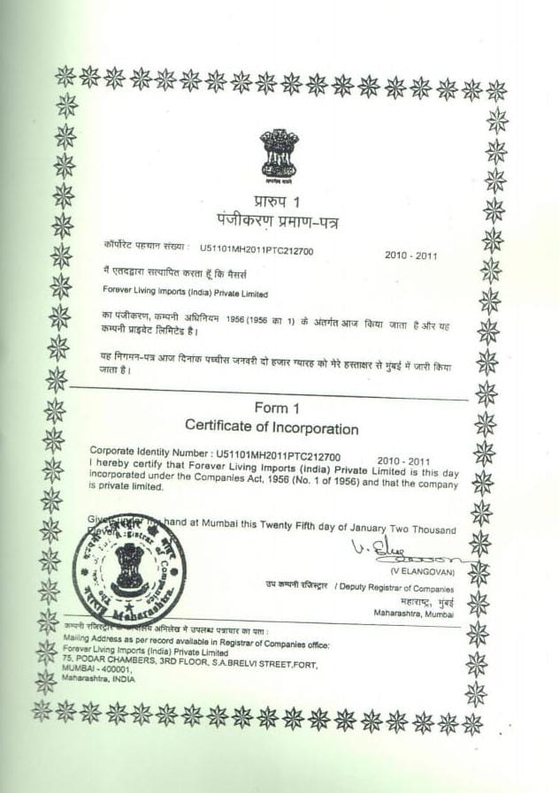

GOVERNMENT REGISTERED PRIVATE COMPANY

Slide 3
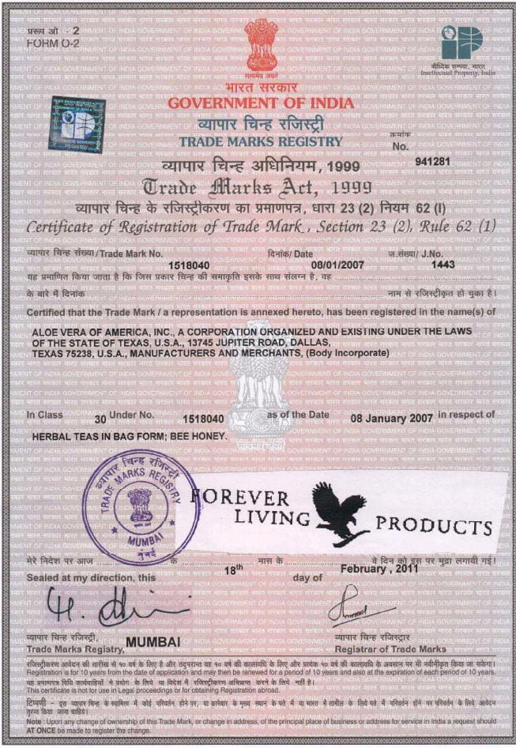
Company trade mark certificate

Slide 4
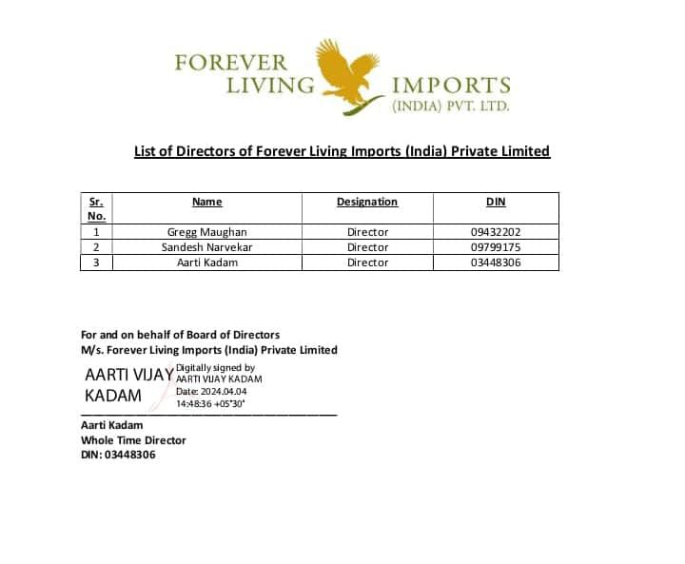
GST NUMBER &FLP DIRECTORS

Slide 5
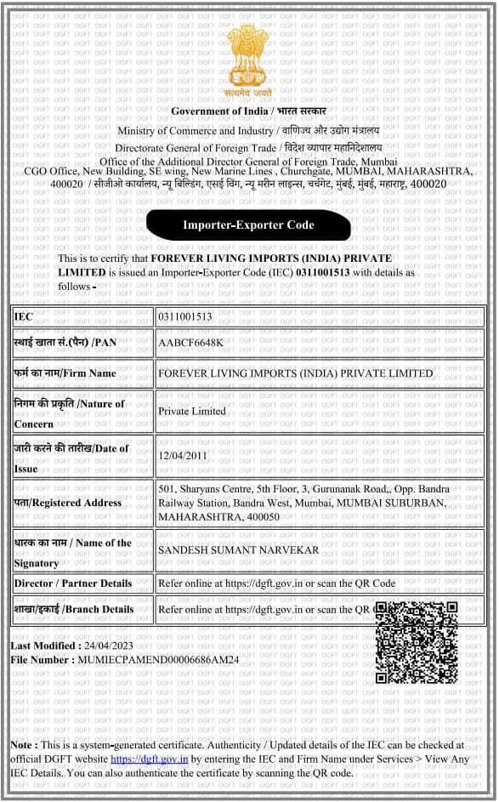
Emport export certificate

Slide 6
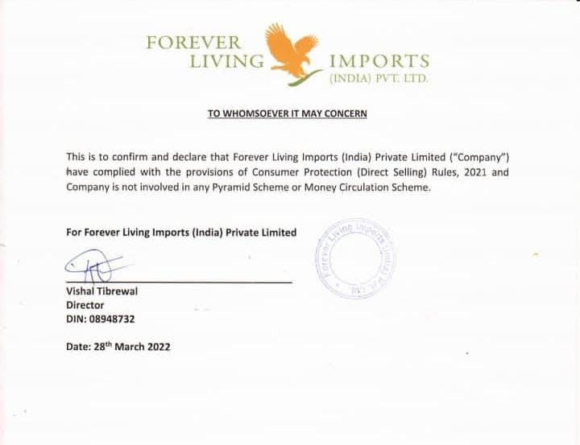
FLP IS NOT MEMBER MAKING SCAM

Slide 7
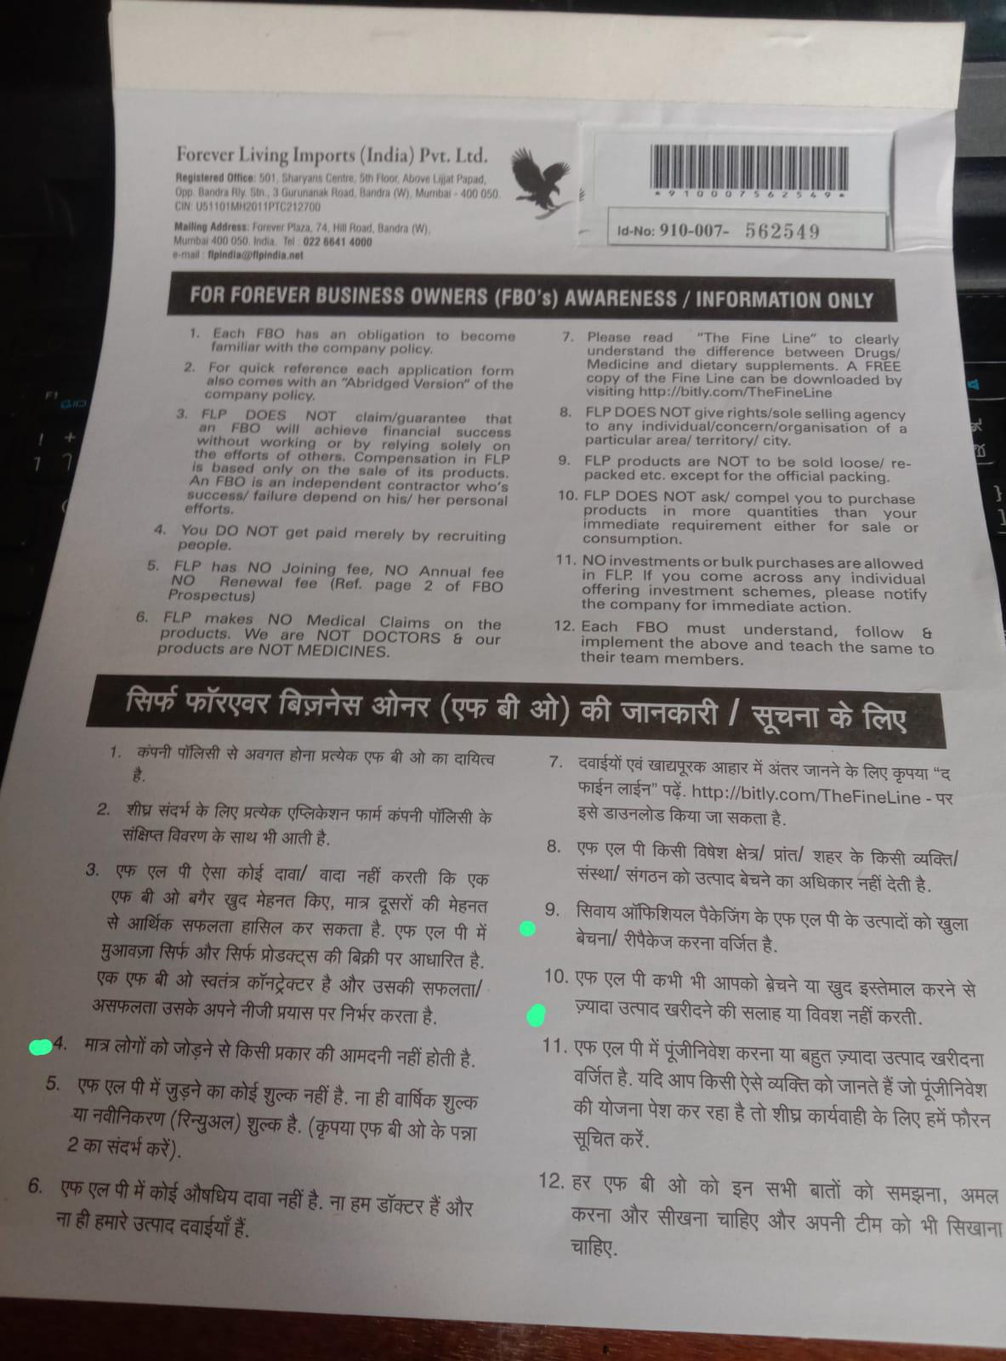
COMPANY FBO INFORMATION

Slide 8
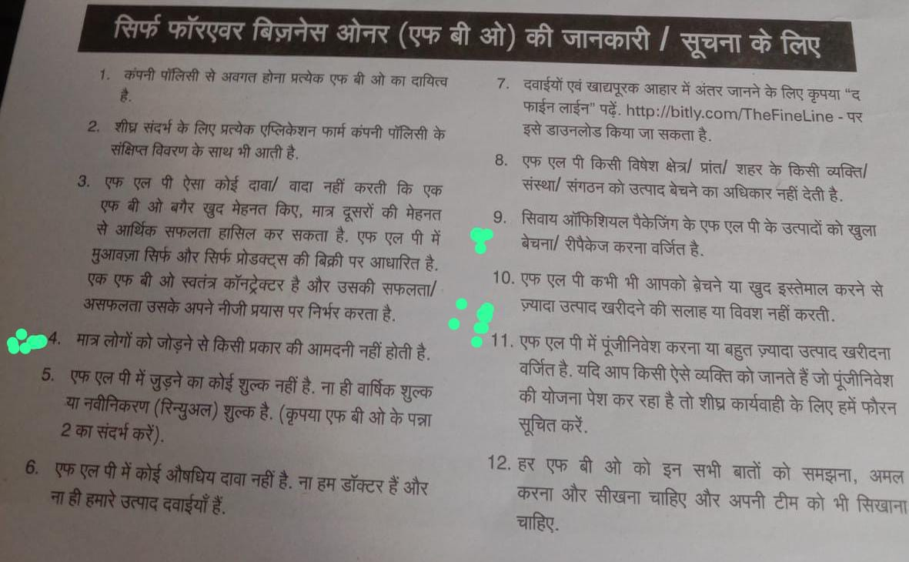

Slide 9
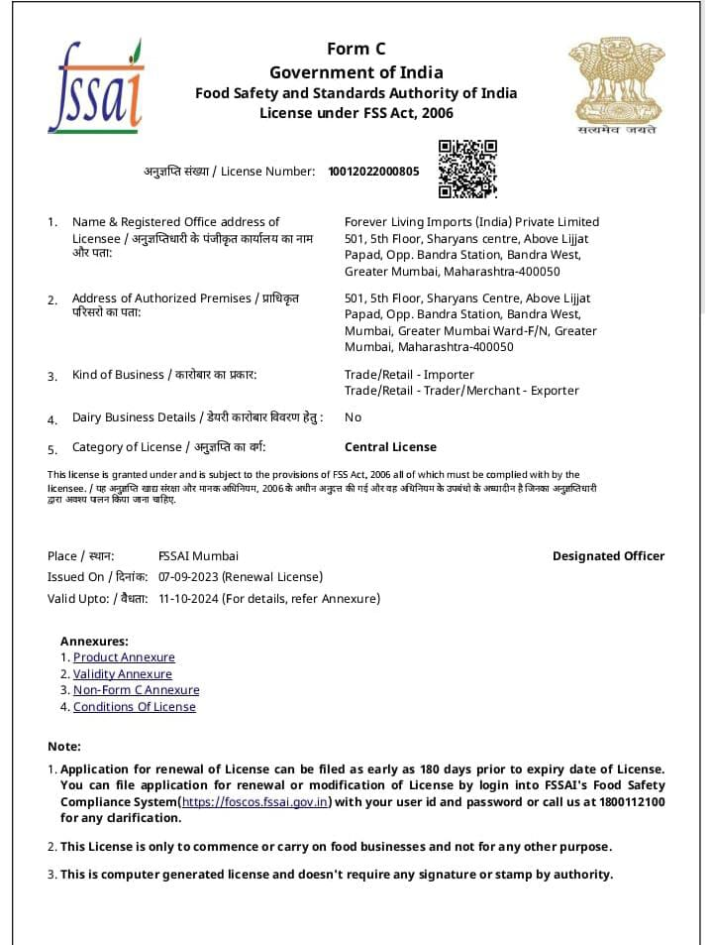

INDIAN TOP FSSAI CETIFICATE

Slide 10
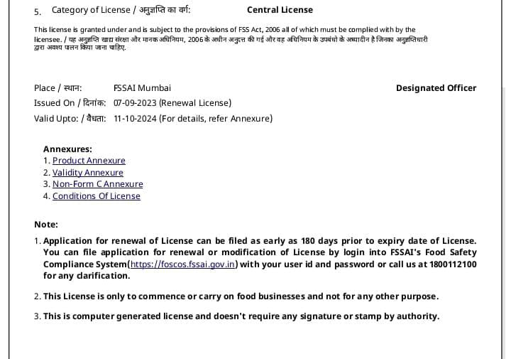
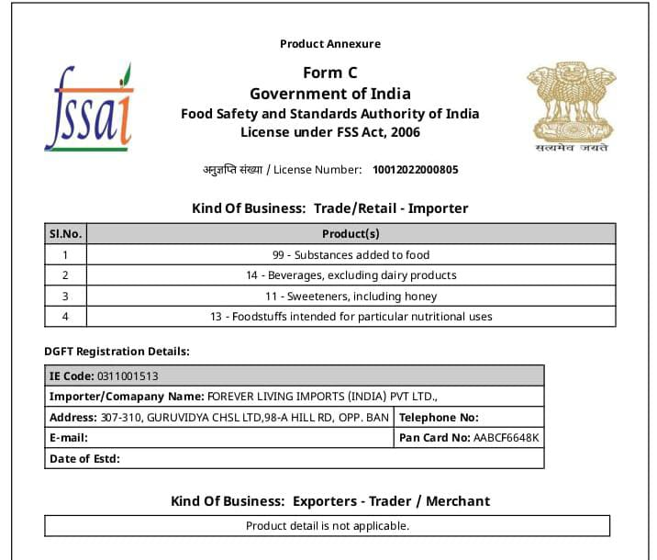


Slide 11
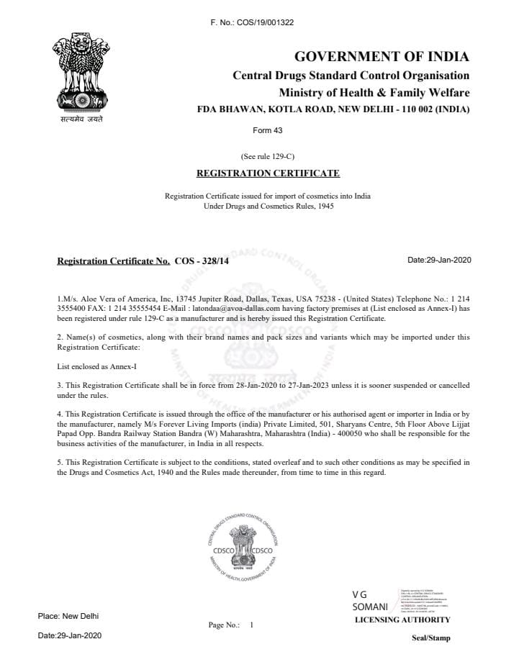

Slide 12

CERTIFICATES & SEALS.

Slide 13
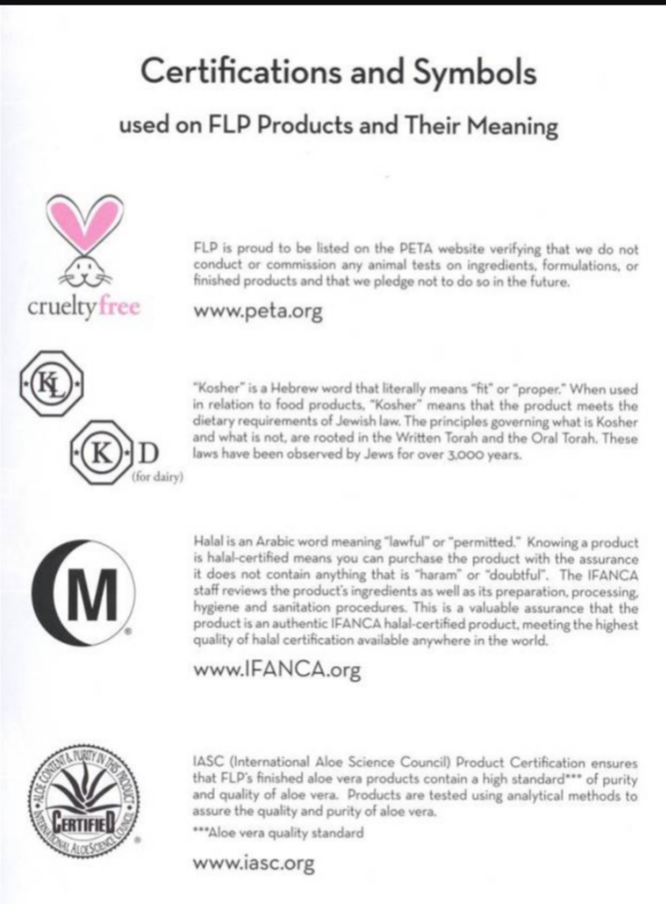

Slide 14
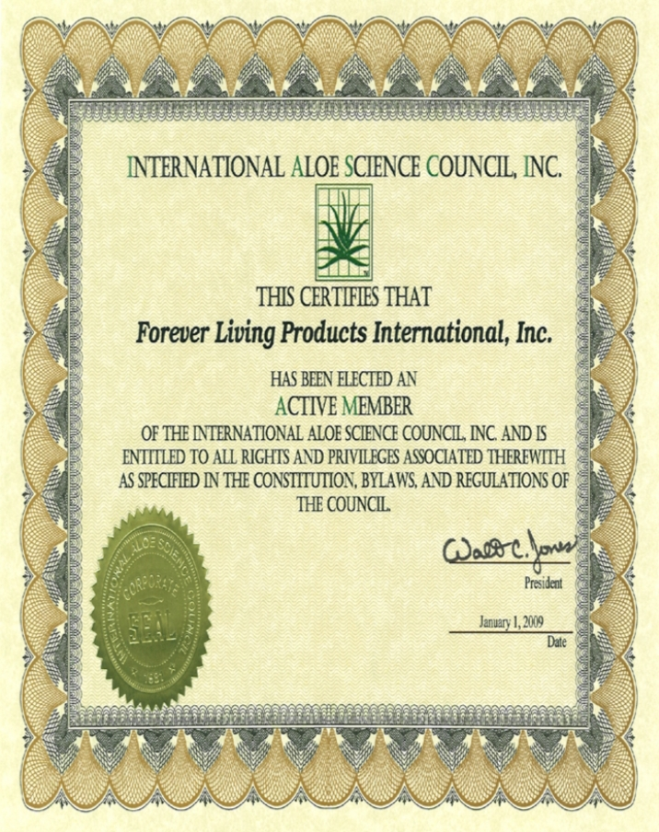
IASC = International aloe science council seal

Slide 15
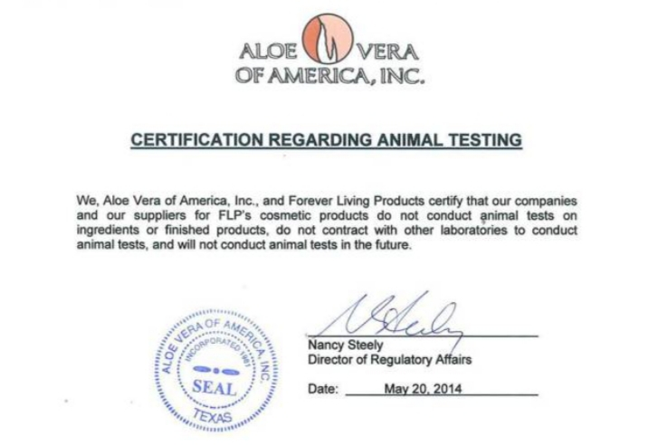
Crulety free certificate

Slide 16
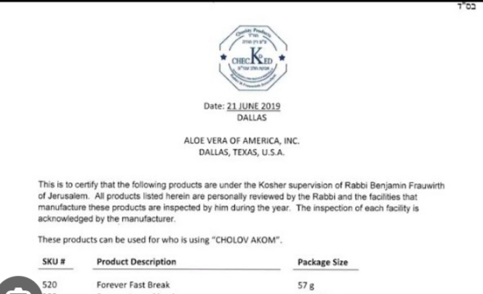
Kosher rating certified

Slide 17
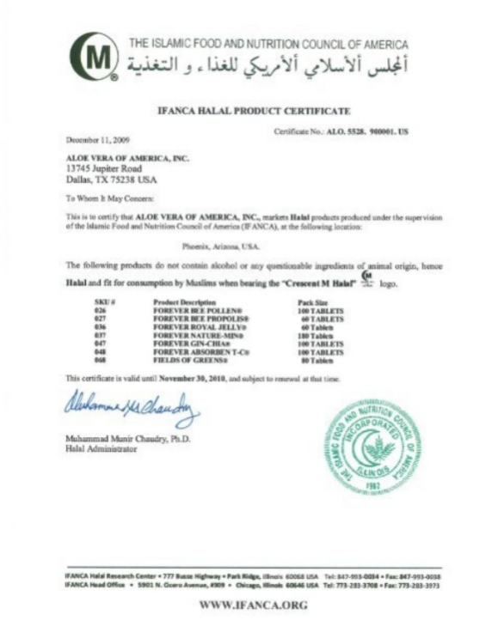
M HALAL CERTIFIED

Slide 18
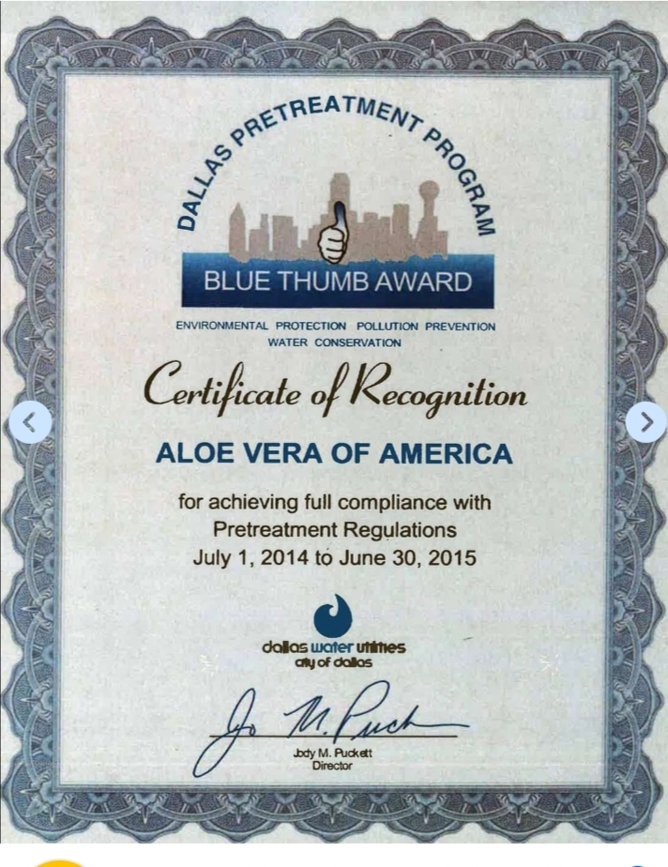
BLUE THUMB AWARD

Slide 19

BRAND OF THE DECADE AWARD

